Slide 1

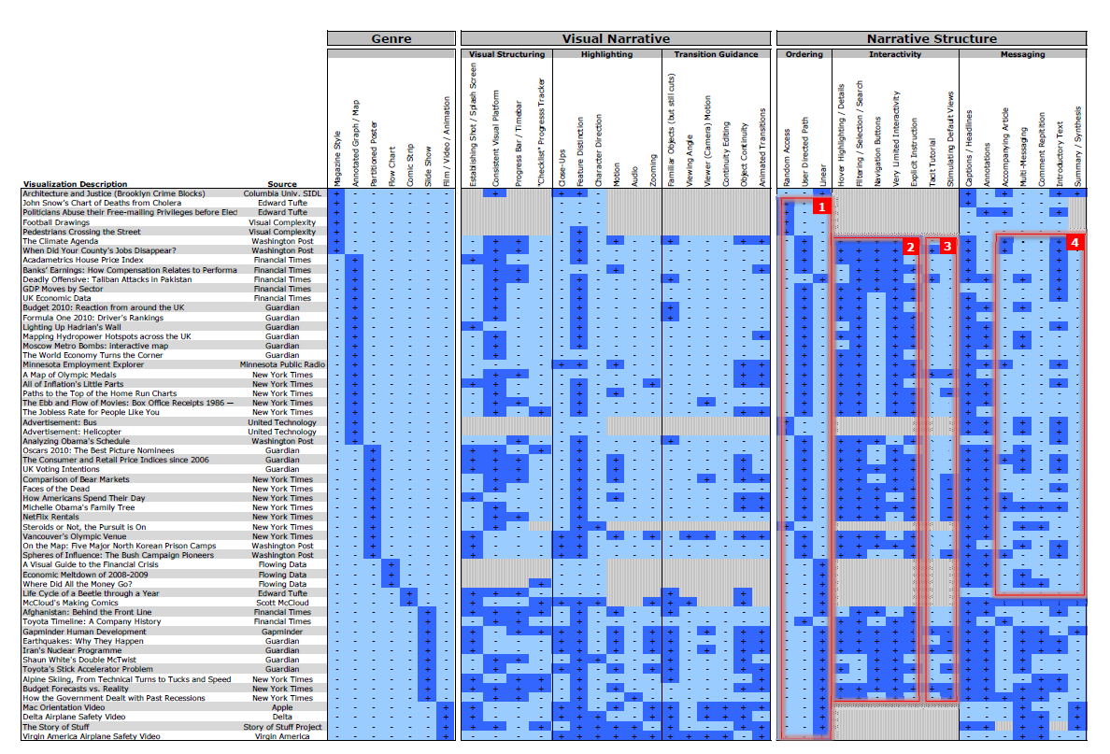
Design Space analysis
After doing thorough analysis of 58 resource articles the author puts forth a design space in form of table depicting various categories for each visualization .
The table categorized the examples based on Genre, Visual Narrative and Structure.

Slide 2
Design space dimensions
Design Space gives three divisions of features: (1) genre, (2) visual narrative tactics, and (3) narrative structure tactics
The Narrative Visualization is divided amongst seven Genres. Ref Fig.
Visual Narrative Tactics are the visual devices that assist and facilitate the narrative.
Narrative structure tactics are identified that are used by each visualization, or non-visual mechanisms that assist and facilitate the narrative.

Slide 3
Design space observation
Three important patterns stand out from the data from Space Analysis: (1) the clustering of different ordering structures, (2) the consistency of interaction design, and (3) the under-utilization of narrative messaging.
The first suggests clear differences between how visualizations guide the viewer through their content.
The second highlights the consistency in interaction design choices made by visualizations.
The third shows the under-utilization of common narrative messaging techniques such as repetition of key points, introductory texts, and final summaries and syntheses.

Slide 4
Balancing Author-driven and reader-driven stories
The Narrative Genres, must together balance the narrative intended by the author on basis of interaction and messaging for the story discovery part of the reader.
Purely Author-Driven approach has a linear path, relies on messaging than interactivity.
Purely reader-driven approach has no prescribed ordering of images, no messaging, and a high degree of interactivity.
Our examples use a variety of hybrid models, some common ones are :
Martini Glass Structure: Begins with Author-Driven and gradually moves to Reader-Driven.
Interactive Slideshow : As name suggests it follows a slideshow format with an interactive mid-narrative per slide.
Drill Down Story : The Drill-Down Story visualization structure presents a general theme and then allows the user to choose among particular instances of that theme to reveal additional details and backstories. This structure puts more emphasis on the reader-driven approach.

